Slide 1
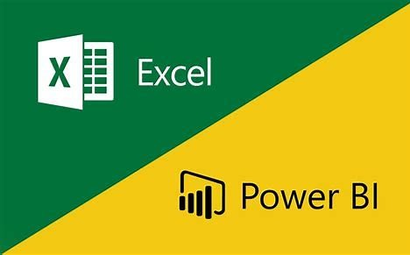
HR Analytics Dashboard Using Power Bi
PRESENTED BY :
KAVYA NALAMOTHU

Slide 2
Importance of Tracking Attrition Rates
Tracking attrition rates is essential for organizations to maintain workforce stability and productivity.
High attrition rates can indicate underlying issues such as employee dissatisfaction or ineffective management.
By analyzing attrition data, organizations can improve retention strategies and overall employee engagement.
2
Notes:
Image source: https://www.slidemake.com

Slide 3
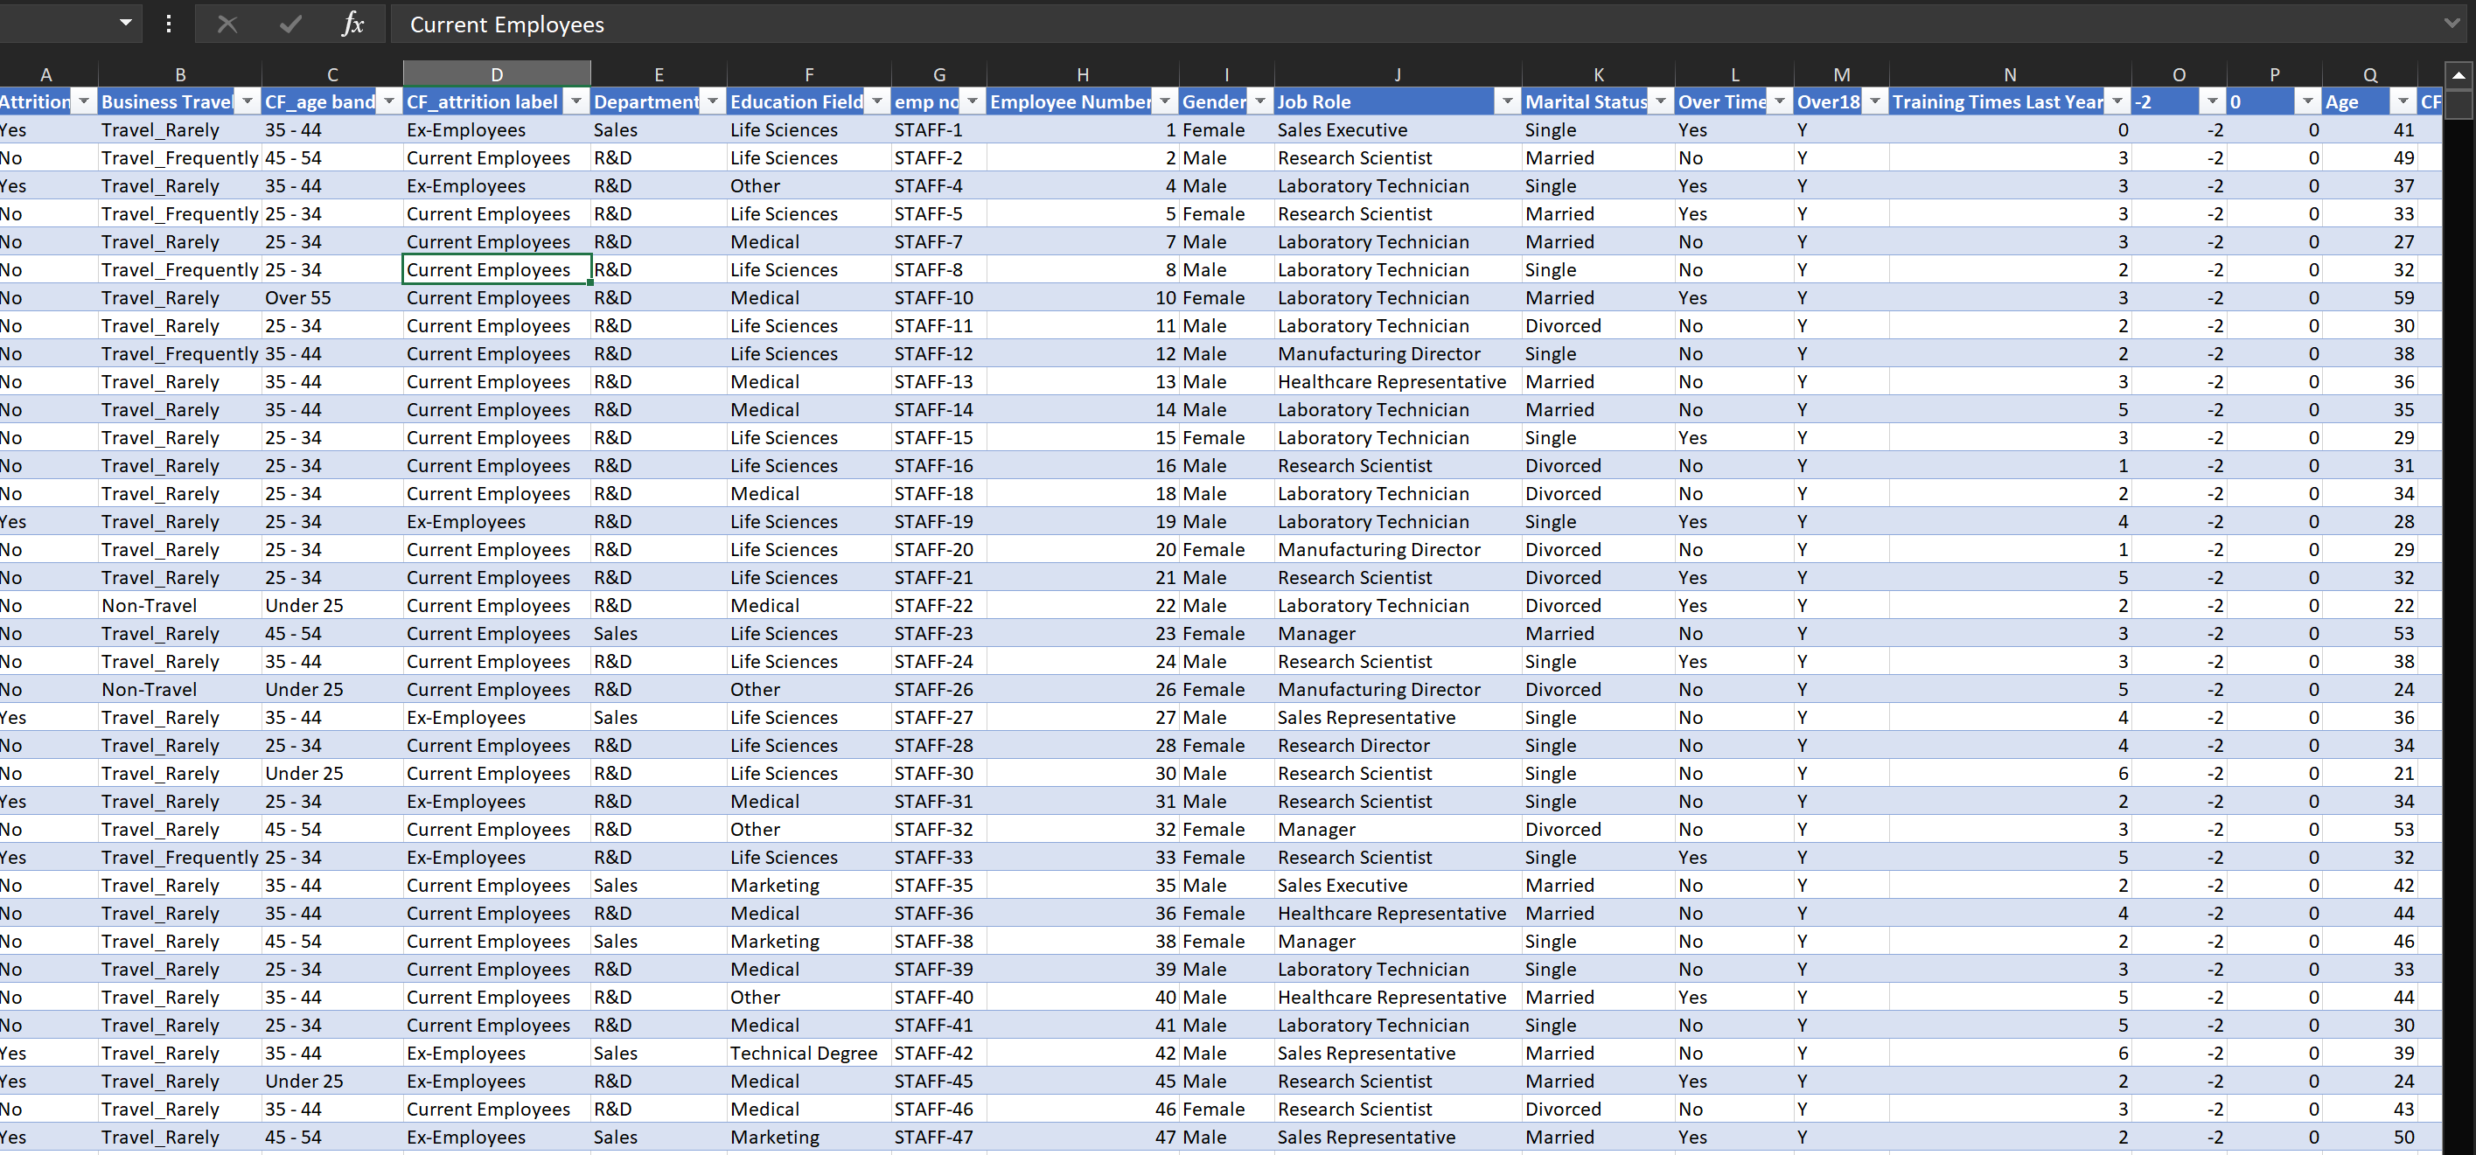
Introduction to HR dataset
HR attrition data refers to the metrics and analytics related to employee turnover within an organization.
Understanding attrition rates helps organizations identify trends and potential issues within their workforce.
1
Notes:
Image source: https://www.slidemake.com

Slide 4
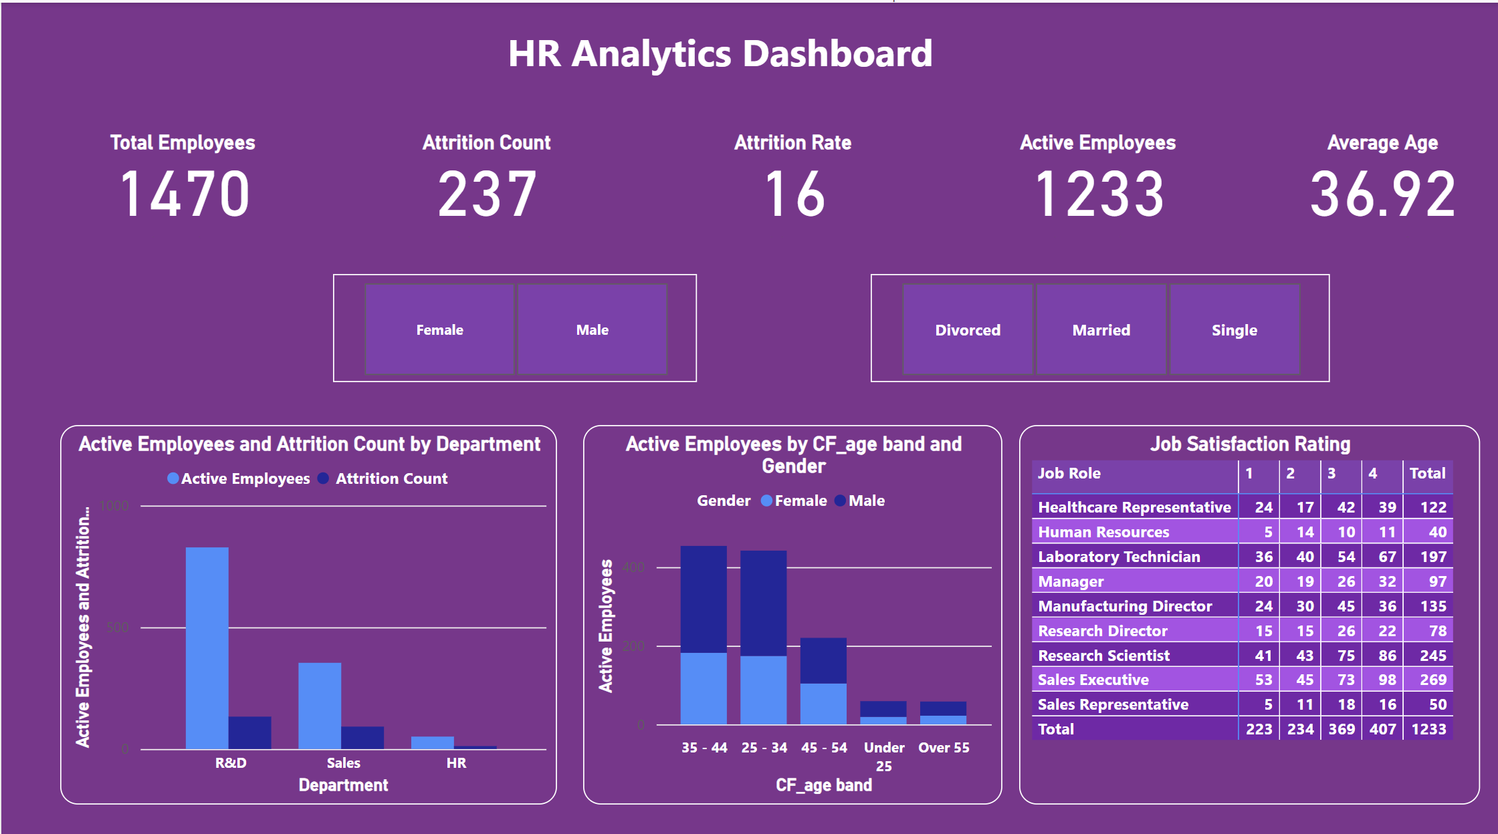
Notes:
Image source: https://www.slidemake.com

Slide 5
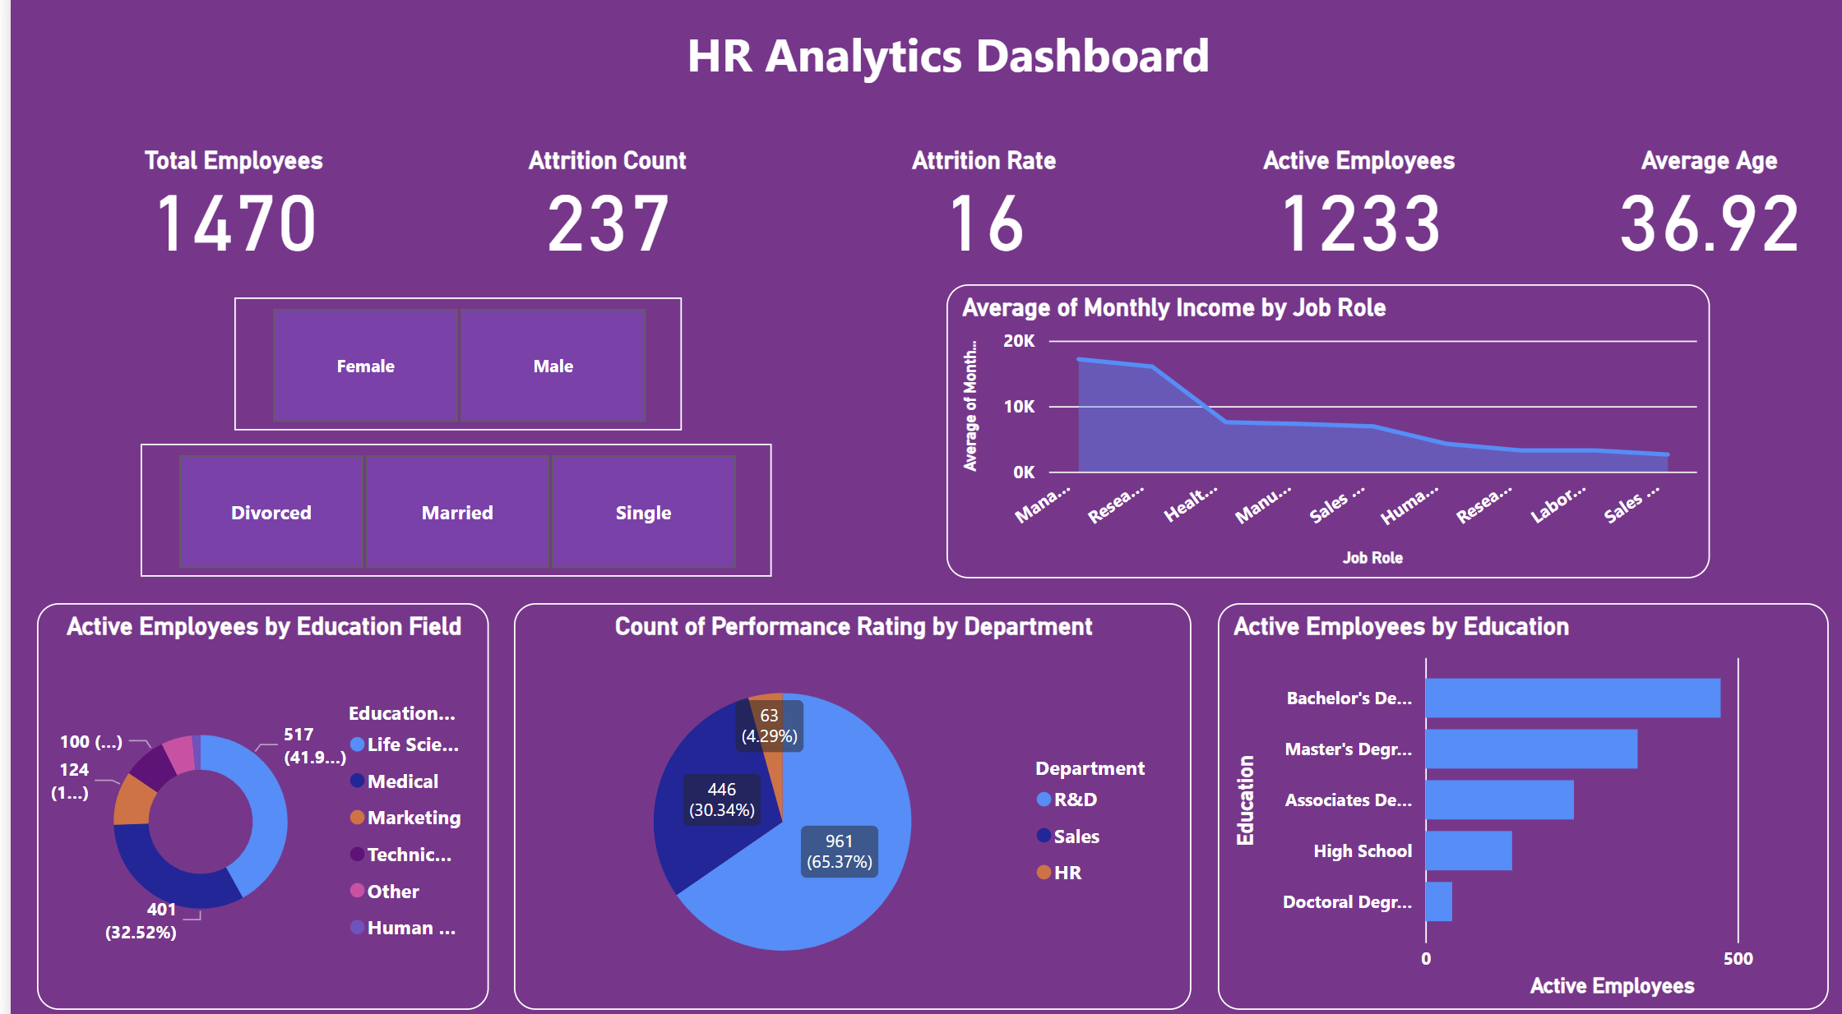

Slide 6
Key Metrics in Attrition Analysis
Key metrics include overall attrition rate and demographic breakdowns.
Analyzing these metrics allows organizations to pinpoint specific areas of concern.
Power BI dashboards can visualize these metrics for easier interpretation and decision-making.
3
Notes:
Image source: https://www.inetsoft.com

Slide 7

Analyzing Factors Influencing Attrition
Factors influencing attrition may include work environment, salary, and career advancement opportunities.
Power BI allows for correlation analysis, helping to understand the relationship between these factors and attrition rates.
Identifying these factors enables organizations to implement targeted interventions to reduce turnover.
4
Notes:
Image source: https://i.pinimg.com

Slide 8

Predictive Analytics in Attrition Management
Predictive analytics in Power BI can forecast future attrition trends based on historical data.
By leveraging machine learning algorithms, organizations can identify employees at risk of leaving.
Proactive measures can then be taken to engage at-risk employees and enhance retention.
5
Notes:
Image source: https://www.slidemake.com

Slide 9
Conclusion
Understanding HR attrition data is crucial for enhancing workforce management strategies.
Utilizing Power BI for data analysis can lead to informed decision-making and better retention outcomes.
Organizations should prioritize investing in data analytics capabilities to drive continuous improvement in their HR practices.
6
Notes:
Image source: https://miro.medium.com

Slide 10


